Slide 1
Agenda
Azure Boards
Introduction to Azure Boards
Azure DevOps Process Templates
CMMI vs. Agile vs. Scrum
DevOps vs. Agile
Scrum Process
Basic vs. Agile vs. Scrum vs. CMMI
Kanban Board
Velocity

Slide 2
Azure Boards
Used to Plan Your work/sprints.
Visualize Your Work/Tasks.
Track user stories, backlog items, task, features, and bugs associated with your project.
You track work by adding work items based on the process and work item types.

Slide 3
Azure DevOps Process Templates
Azure DevOps Process
Basic
Agile
Scrum
CMMI

Slide 4
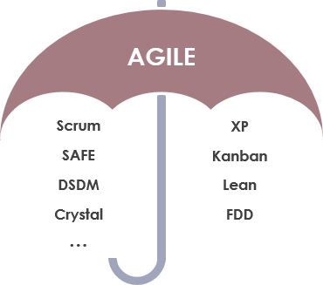
CMMI vs. Agile vs. Scrum
CMMI (Capability Maturity Model Integration) is used for the improvement of the current process to attain certain levels
Agile is a methodology that promotes continuous iteration of development and testing in the software development process.
Scrum is an Agile process to focus on delivering the business value in the shortest time. It deals with the new process.
Notes:
https://www.guru99.com/agile-scrum-extreme-testing.html
https://www.guru99.com/agile-vs-scrum.html
eXtreme Programming (XP)
Dynamic Software Development Method (DSDM)
Feature Driven Development (FDD)
Lean Software Development
Kanban
Agile is the name given to a group of software development methodologies that are designed to be more lightweight and flexible than previous methods such as waterfall. Devops adopts and extends Agile principles and applies them to the entire organization, not only the development process.

Slide 5
DevOps vs. Agile
Features | DevOps | Agile
Agility | Agility in both Development & Operations | Agility in only Development
Processes/Practices | Involves processes such as CI, CD, CT, etc. | Involves practices such as Scrum, Kanban, etc.
Key Focus Area | Timeliness & quality have equal priority | Timeliness is the main priority
Release Cycles | Smaller release cycles with immediate feedback | Smaller release cycles
Source of Feedback | Feedback is from monitoring tools | Feedback is from customers
Scope of Work | Agility & need for Automation | Agility only
Notes:
DevOps is a successor to Agile.

Slide 6
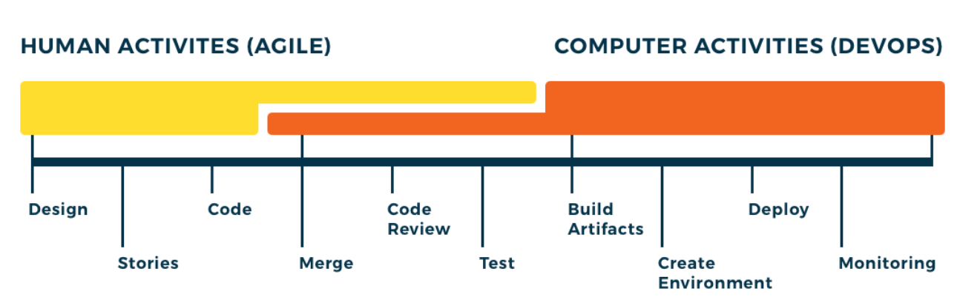
DevOps vs. Agile
Customer
Developer
Operation
Agile
DevOps
Notes:
DevOps ⊂ Agile ⊂ Lean Thinking ⊂ Waterfall
https://opensource.com/article/18/11/analyzing-devops

Slide 7
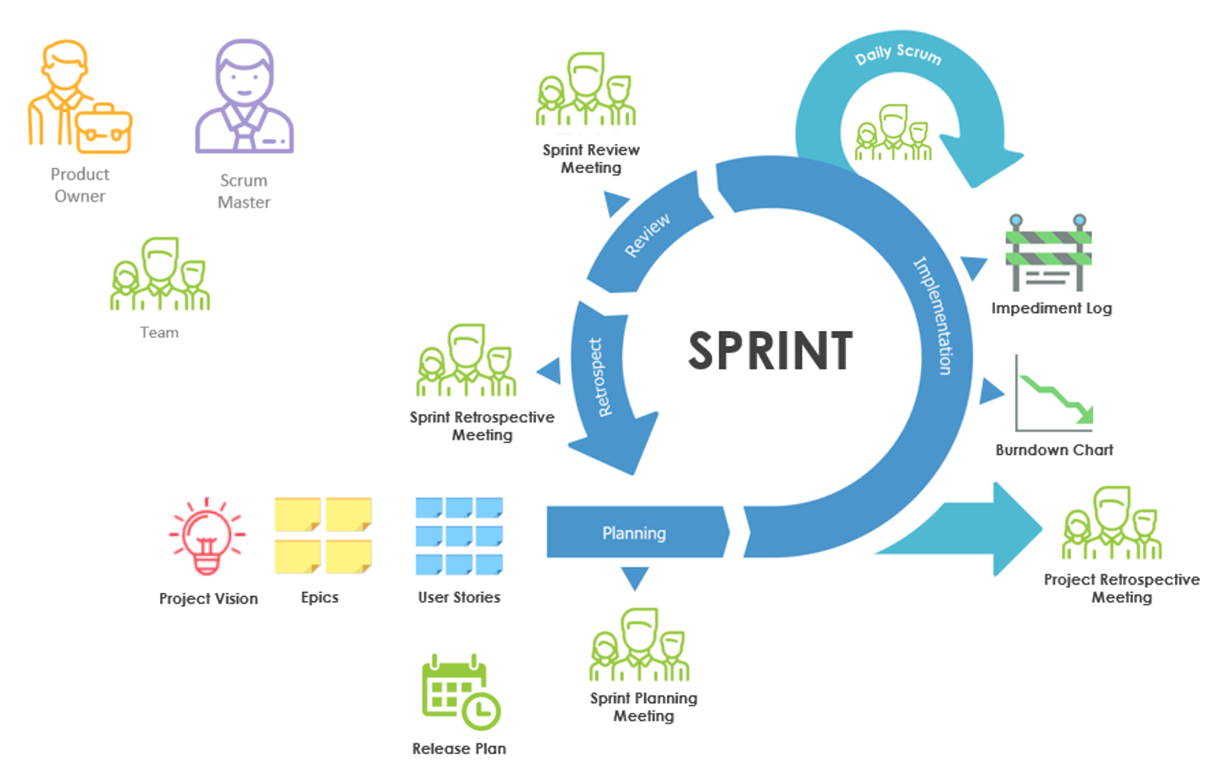
Agile - How Does Scrum Work?
Notes:
Retrospective - looking back on or dealing with past events or situations.
Impediment – unplanned activities/Issue which impact delivery
Product Owner: The person with the product vision
Scrum Master: The scrum expert who helps the team build the product according to the scrum framework
Development Team: The team members who execute the work
A Product Owner owns the Product backlog and writes user stories and acceptance criteria.
A Product Owner is responsible for prioritizing the Product Backlog is prioritized and decides the release date and the content.
A Product Owner accepts or rejects product backlog item.
A Product Owner has the power to cancel the Sprint, if he thinks the Sprint goal is redundant.
A Product Owner is the one who is responsible for the Return on Investment (ROI) of the product.
A Scrum Master is a facilitator and Servant Leader who encourages and demands self-organization from the development team.
A Scrum Master enables close cooperation across all roles and functions, addresses resource issue and disobedience of scrum practices.
A Scrum Master protects the team from external and internal distractions.
A Scrum Master removes impediments so the team can focus on the work at hand and follow scrum practices.
A Scrum Master is not typically a manager or lead, but he is an influential leader and coach who does not do direct command and control.
The Development Team builds the product that the Product Owner indicates: the application or website, for example. The Team in Scrum is “cross-functional”
The Development Team includes all the expertise necessary to deliver the potentially shippable product each Sprint
The Development Team is self-organizing, with a very high degree of autonomy and accountability.
The Development Team decides how many items to build in a Sprint, and how best to accomplish that goal.
The Development Team is a cross functional, small and self-organizing team which owns the collective responsibility of developing, testing and releasing the Product increment.
The Development Team may not appoint any team lead since decisions are taken collectively by the team.

Slide 8
Scrum
Product Owner: The person with the product vision
Scrum Master: The scrum expert who helps the team build the product according to the scrum framework
Development Team: The team members who execute the work
Retrospective - looking back on or dealing with past events or situations.
Impediment – unplanned activities/Issue which impact delivery

Slide 9
Product Owner
A Product Owner owns the Product backlog and writes user stories and acceptance criteria.
A Product Owner is responsible for prioritizing the Product Backlog is prioritized and deciding the release date and the content.
A Product Owner accepts or rejects product backlog items.
A Product Owner has the power to cancel the Sprint if he thinks the Sprint goal is redundant.
A Product Owner is the one who is responsible for the Return on Investment (ROI) of the product.

Slide 10
Scrum Master
A Scrum Master is a facilitator and Servant Leader who encourages and demands self-organization from the development team.
A Scrum Master enables close cooperation across all roles and functions, and addresses resource issue and disobedience of scrum practices.
A Scrum Master protects the team from external and internal distractions.
A Scrum Master removes impediments so the team can focus on the work at hand and follow scrum practices.
A Scrum Master is not typically a manager or lead, but he is an influential leader and coach who does not do direct command and control.

Slide 11
Development Team
Build the product that the Product Owner indicates: the application or website, for example. The Team in Scrum is “cross-functional”
Includes all the expertise necessary to deliver the potentially shippable product for each Sprint
Self-organizing, with a very high degree of autonomy and accountability.
Decides how many items to build in a Sprint, and how best to accomplish that goal.
Cross functional, small, and self-organizing team which owns the collective responsibility of developing, testing, and releasing the product increment.
The Development Team may not appoint any team lead since decisions are taken collectively by the team.

Slide 12
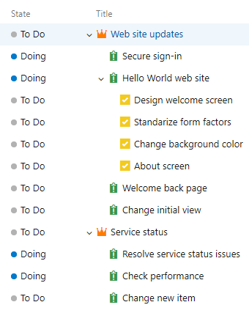
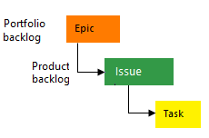
Basic Process

Slide 13
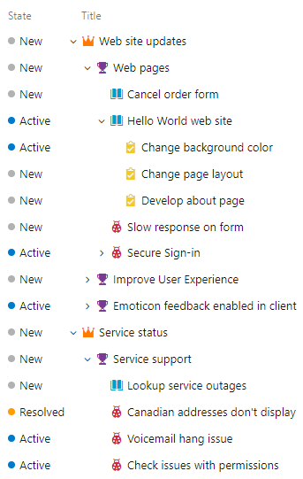
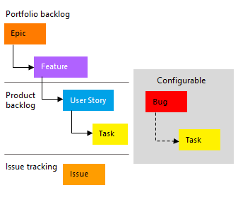
Agile Process
Epic -> Months -> Deliver in multiple sprints.
Feature -> Weeks -> Deliver in 2 or more sprints.
User Story/Product Backlog Item -> Days -> Deliver in single sprint
Task -> Hours
Notes:
Epic -> Months -> Deliver in multiple sprints.
Feature -> Weeks -> Deliver in 2 or more sprints.
User Story/Product Backlog Item -> Days -> Deliver in single sprint
Task -> Hours
- Epic: A very large user story that is eventually broken down into smaller stories.
- User story: A very high-level definition of a requirement, containing just enough information so that the developers can produce a reasonable estimate of the effort to implement it.
- Feature: A distinguishing characteristic or capability of a software application or library (e.g., performance, portability, or functionality).
- A Feature is not a User Story.
- An Epic is a User Story.
- A User Story may be an Epic.
- A User Story can contain many Features.
A Feature can fulfill 1 to many User Stories.
Bug- Any problem in existing functionality, or missing functionality. Defect in code or requirement, error which is not designed to be.
Issue (Impediment)- Any problem which might block the development process, example : a third party driver you identified as dependency is not releasing on time, so it is an issue in your development process.
Task- Any work which is planned as part of development of your project, either as result of bug, or issue or requirements, including requirement analysis or development, or testing. etc.

Slide 14
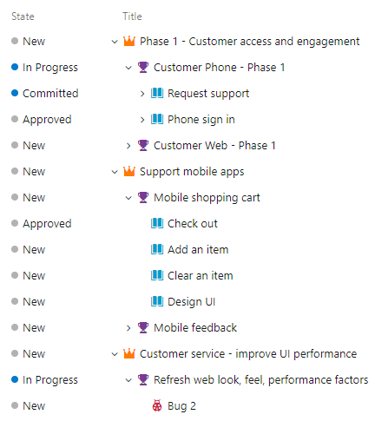
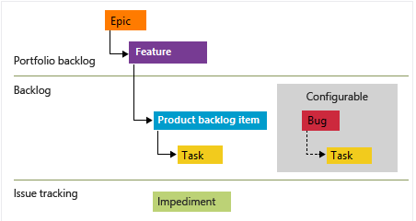
Scrum Process

Slide 15
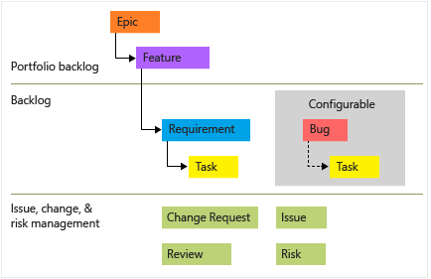
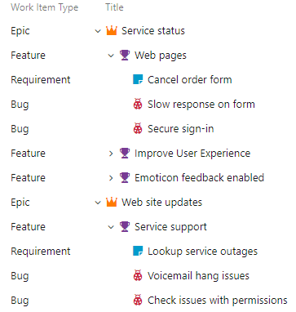
CMMI Process

Slide 16
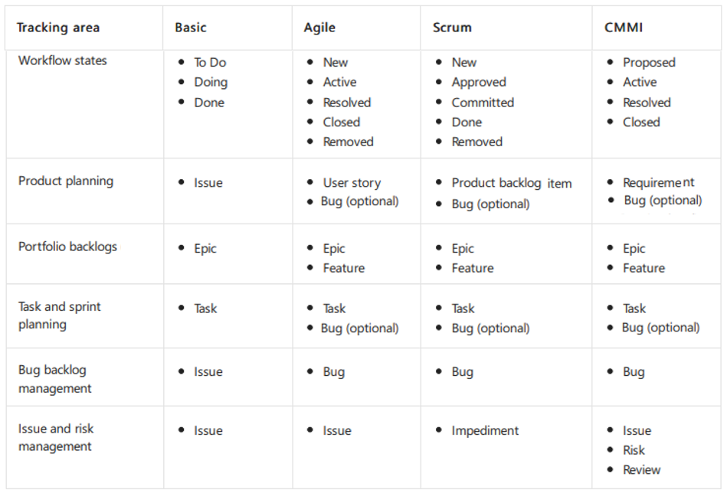
Basic vs. Agile vs. Scrum vs. CMMI

Slide 17
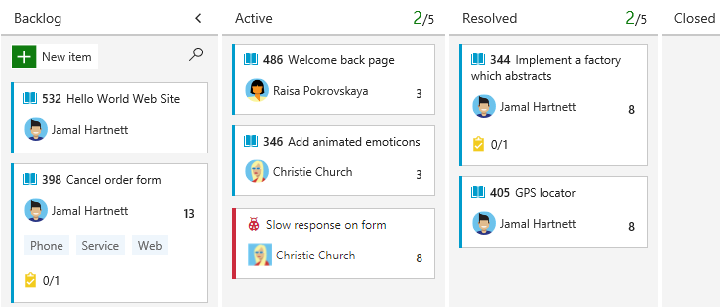
Kanban Board
Kanban board is useful for visualizing and track project progress.
Easily identify who is working on what tasks and the status of those tasks.
Create transparency between the team and the stakeholders.
Easy and user-friendly status change option by just drag-and-drop.
Notes:
https://docs.microsoft.com/en-us/azure/devops/learn/agile/what-is-kanban

Slide 18
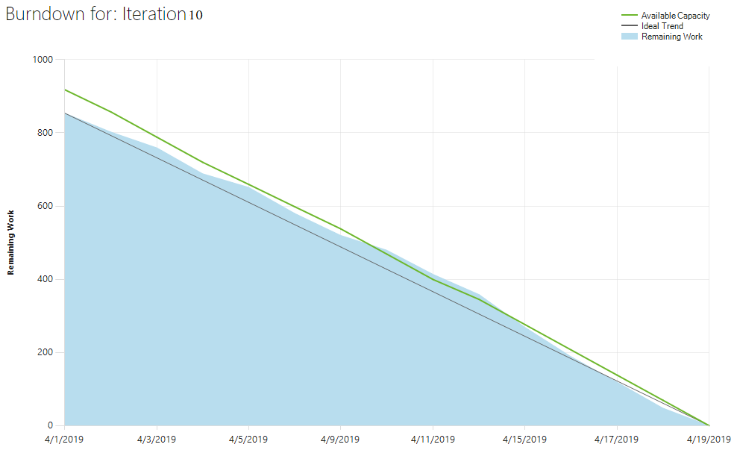
Burndown Graph
Burndown graph represents the remaining work of a Scrum Team.
The vertical axis represents the story points or hours and the horizontal axis represents the dates (between the sprint start date and end date).

Slide 19
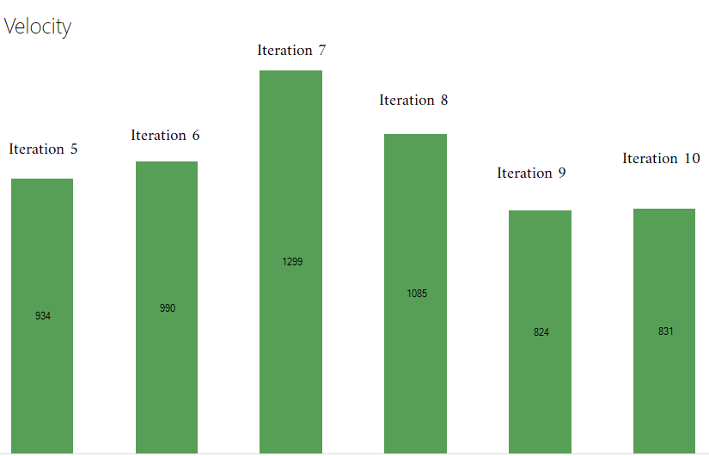
Velocity
Velocity is the measurement of backlog items completed in a single sprint by Team members.
Helps in forecasting future sprints and the backlog items that a team can complete.
Notes:
https://docs.microsoft.com/en-us/azure/devops/report/dashboards/cumulative-flow-cycle-lead-time-guidance?view=azure-devops

